Slide 1
Computer Graphics and Image Processing
Color I

Slide 2
Today’s Outline
Colors in the Real World
Interaction of Light with Materials
Human Perception of Light

Slide 3
COLORS IN THE REAL WORLD

Slide 4
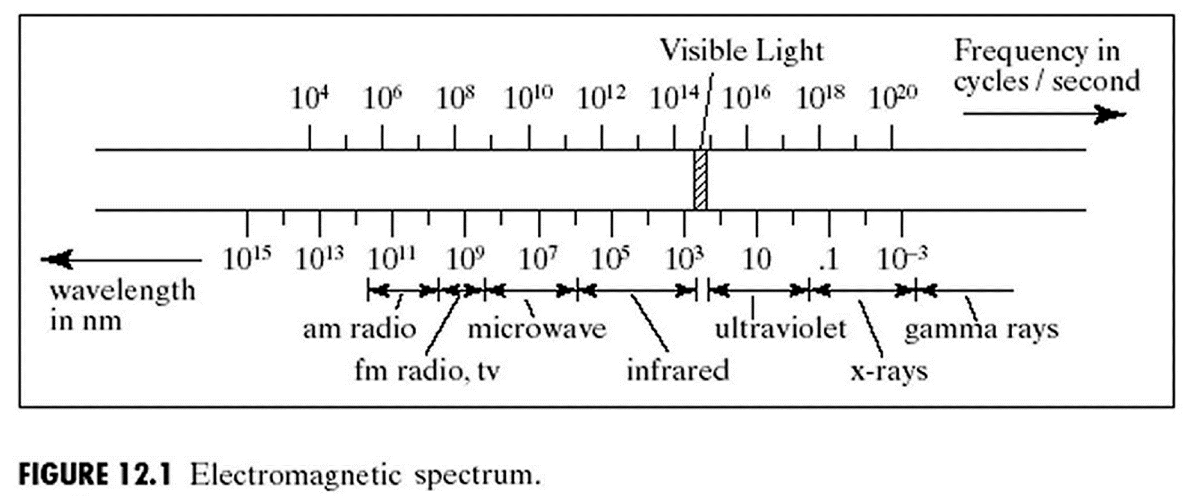
Electromagnetic Radiation: Waves
Physics theories of light:
waves (classical mechanics)
particles (quantum mechanics)
frequency = cycles/sec.
frequency * wavelength = speed of light f * λ = c = 3.0 × 10⁸ m/sec
wavelength, λ
© 2004 Lewis Hitchner, Richard Lobb & Kevin Novins

Slide 5
Some Neighbors of Visible Light
1000 nm
Infrared
Invisible
Radio
TV
700 nm
Red
Orange
Microwaves
Yellow
Visible light, a.k.a. the “visible spectrum” “ROYGBIV”
Infrared
Green
Wavelength
Visible Light
Blue
UV Rays
Indigo
X-Rays
Violet
400 nm
Ultra- violet (UV)
Gamma
Rays
Invisible
10 nm
© 2004 Lewis Hitchner, Richard Lobb & Kevin Novins

Slide 6
Spectral Density Function (SDF): S(λ)
S(λ) = power / unit wavelength = energy
Energy
Energy
400
Wavelength λ (nm)
700
400
Wavelength λ (nm)
700
spike or “single” wavelength = “spectral colour”
uniform white/gray light
Energy
Energy
400
Wavelength λ (nm)
700
400
Wavelength λ (nm)
700
white light plus a dominant wavelength
arbitrary SDF: blue plus orange/yellow
© 2004 Lewis Hitchner, Richard Lobb & Kevin Novins

Slide 7
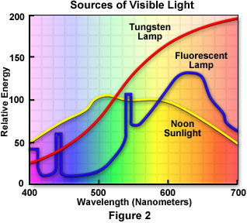
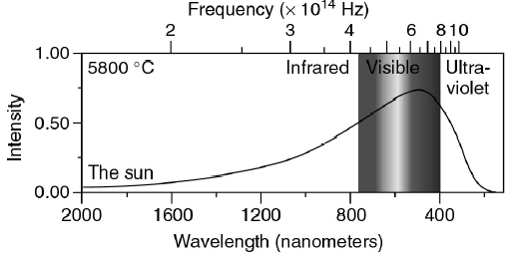
SDFs for Different Light Sources
Some other light spectra: sunlight, tungsten lamp, fluorescent lamp
http://www.micro.magnet.fsu.edu/optics/lightandcolor/sources.html
© 2004 Lewis Hitchner, Richard Lobb & Kevin Novins

Slide 8
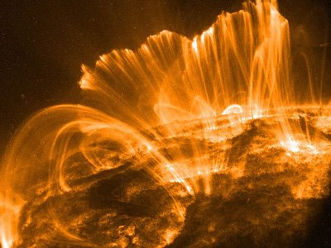
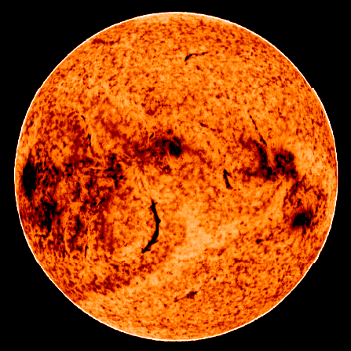
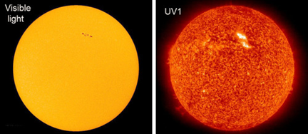
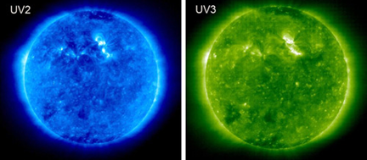
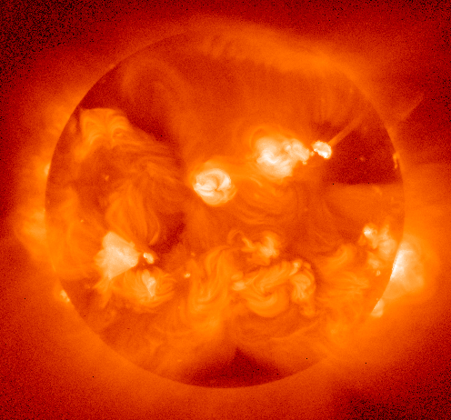
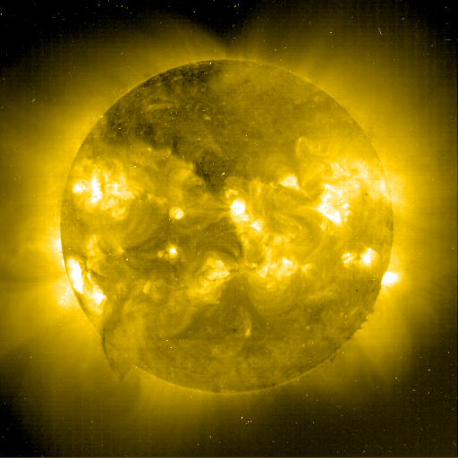
The Sun (across the electromagnetic spectrum)
Low frequency
IR
X-ray
Gamma-ray

Slide 9
Describing Colors using the SDF
Hue: dominant wavelength
Luminance (brightness): total power (integral of SDF)
Saturation (also purity): % of luminance residing in dominant component
Energy
400
Wavelength λ (nm)
700
high S med L
high S low L
Energy
Energy
400
Wavelength λ (nm)
700
400
Wavelength λ (nm)
700
Energy
Energy
low S low L
low S high L
400
Wavelength λ (nm)
700
400
Wavelength λ (nm)
700

Slide 10
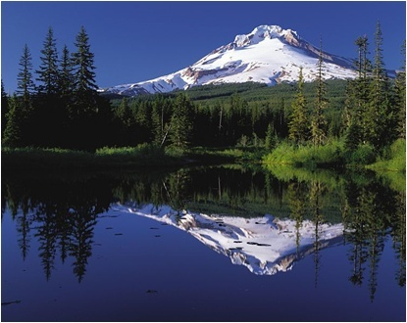
INTERACTION OF LIGHT WITH MATERIALS

Slide 11
Interaction of Light with Materials
Light ⇨ surface of some “body”: 3 possible results
Absorption – energy of selected wavelengths retained within the body
Transmission – energy of selected wavelengths travels through and exits the body. Refraction of light occurs at boundaries.
Reflection – energy of selected wavelengths “bounces” off surface. Angle of reflection = angle of incidence.
Also combinations of these 3, such as “internal reflection” when light enters a semi-translucent body, scatters, and some light reflects back out: human skin, Shrek’s skin
R = reflected energy
A = absorbed energy
I = incident (incoming) energy
T = transmitted energy
© 2004 Lewis Hitchner, Richard Lobb & Kevin Novins

Slide 12
Interaction of Light with Materials
Incident (incoming) light energy = absorbed energy + transmitted energy + reflected energy = retained + passed through + bounced off
Chemical properties of the body determine the % of each.
Computer graphics: reflected (and refracted), transmitted light
opaque coloured surface: A > 0 , T = 0, R > 0
opaque black surface: A = I ,T = 0, R = 0 (black felt cloth)
perfect mirror surface: A = 0, T = 0, R = I
transparent surface: A, R small, T ~= I (clear glass)
© 2004 Lewis Hitchner, Richard Lobb & Kevin Novins

Slide 13
Spectral Response Function (SRF)
Molecular structure of a body determines which wavelengths of light and what amount are absorbed, transmitted, or reflected
Can be measured with a spectral response function (SRF) or filter function
100%
100%
% Energy
% Energy
0%
0%
400
Wavelength λ (nm)
700
400
Wavelength λ (nm)
700
All pass filter (ideal , real )
low pass and high pass filters
100%
100%
% Energy
% Energy
0%
0%
400
Wavelength λ (nm)
700
400
Wavelength λ (nm)
700
Narrow band filter
Notch filter

Slide 14
Light Source SDF x SRF = Result SDF
SDF of result = product of SRF and light source SDF i.e. at each wavelength, multiply SRF % times source energy
Energy
100%
% Energy
Χ
0%
400
Wavelength λ (nm)
700
400
Wavelength λ (nm)
700
Sunlight SDF
Narrow band filter
Energy
Energy
=
=
400
Wavelength λ (nm)
700
400
Wavelength λ (nm)
700
Filtered sunlight SDF
© 2004 Lewis Hitchner, Richard Lobb & Kevin Novins

Slide 15
SDF x SRF = Result SDF
Why is this relevant for computer graphics?
All light sources can be defined by their SDF
Natural light source: sun, fire
Artificial light source: light bulb, laser, LED, computer display
All light absorbers, transmitters, or reflectors can be defined by their SRF
Sensing devices: absorbed light SRF
Camera (digital photocell, film), human eye (retina)
Definition of “color” = integral of (light source SDF × sensor’s SRF)
Glass, still water, cellophane: transmitted light SRF
Surface material of an object: reflected light SRF
© 2004 Lewis Hitchner, Richard Lobb & Kevin Novins

Slide 16
HUMAN PERCEPTION OF LIGHT

Slide 17
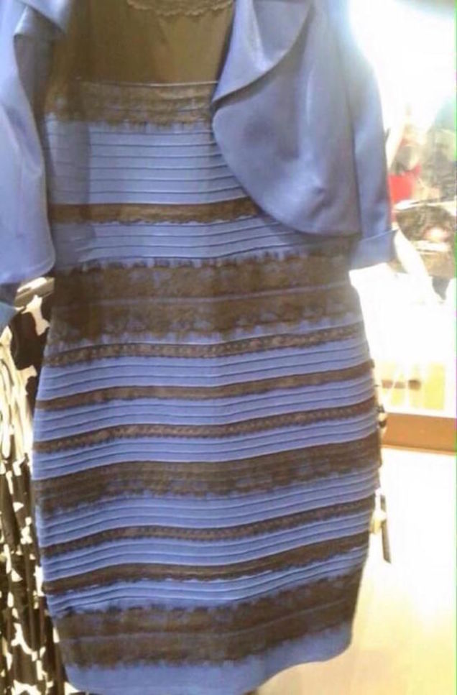
Perception of Light
White/Gold or Blue/Black?

Slide 18
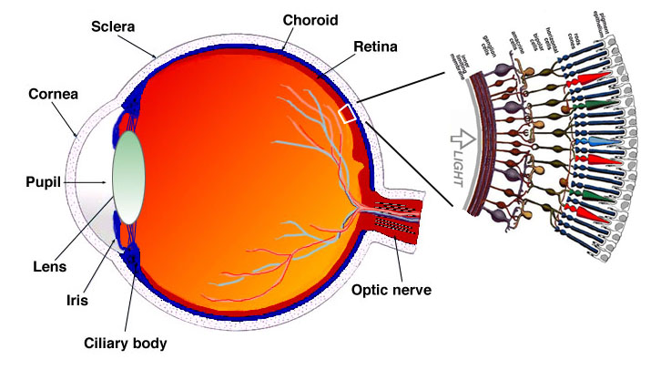
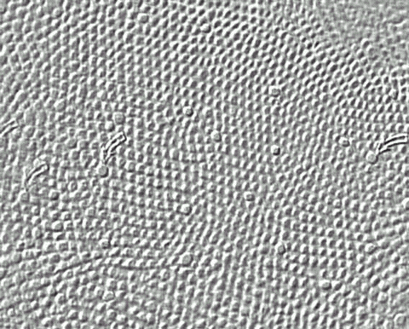
The Eye
Four types of receptors (sensors): R/G/B cones + rods, each has unique SRF
http://webvision.med.utah.edu/imageswv/fovmoswv.jpeg
http://webvision.med.utah.edu/imageswv/Sagschem.jpeg

Slide 19
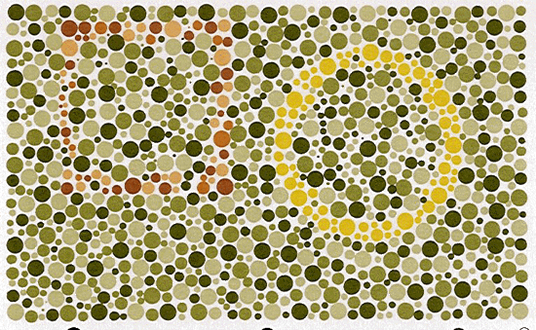
Colour “Blindness”
http://members.aol.com/protanope/card2.html
If you didn’t see both a yellow circle and a faint brown square, you are somewhat “colour blind” (in USA 5.0% of males, 0.5% of females). To find out more, visit: http://www.kcl.ac.uk/teares/gktvc/vc/lt/colourblindness/cblind.htm
© 2004 Lewis Hitchner, Richard Lobb & Kevin Novins

Slide 20
Colors and the SDF
Many different SDFs are perceived by us as the same color!
When describing a color (as seen by the eye) exactly, we do not need to know full SDF
Three parameters are enough
For example: just use hue, luminance and saturation
Energy
Energy
400
Wavelength λ (nm)
700
400
Wavelength λ (nm)
700
© 2004 Lewis Hitchner, Richard Lobb & Kevin Novins

Slide 21
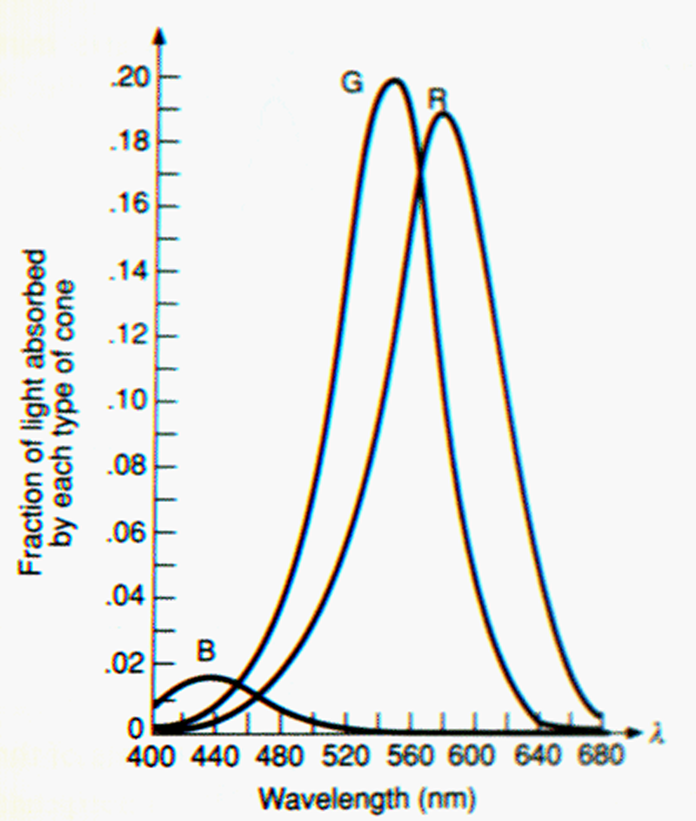
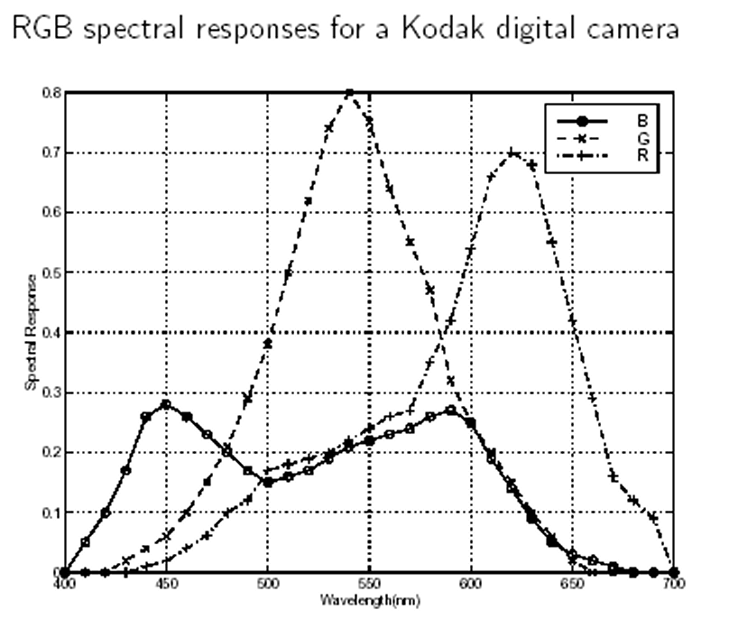
SRFs for the Eye and a Camera
http://www.stanford.edu/class/ee392b/handouts/color.pdf
http://www.ecs.csun.edu/~dsalomon/DC2advertis/AppendH.pdf
© 2004 Lewis Hitchner, Richard Lobb & Kevin Novins

Slide 22
Seeing Red, Green and Blue
A cone cell in the retina measures amount of red, green, or blue wavelength energy (3 SRF’s). Responds only in bright light.
SRF of a rod cell covers all wavelengths (measures “gray level” or intensity) Responds in low light, but not in bright light.
Integral of R, G, or B cone response produces a single value Note: SRF’s really L, M, S wave responses (long, medium, short), not R, G, B. Note: low response of short (blue) is scaled up by vision system (after retina).
=
=
SDF of source
Short (blue)
(scaled)
Χ
=
=
Medium (green)
SRF’s of eye (L, M, S)
=
=
Long (red)
© 2004 Lewis Hitchner, Richard Lobb & Kevin Novins

Slide 23
Seeing Red, Green, Blue (cont’d)
Example L, M, S responses for various SDF’s
Resulting L, M, and S SRF responses are independent values
The 3 SRF response values are interpreted as hues by our brain, e.g. red + green = yellow, red + green + blue = white
=
=
Sunlight SDF
Blue reflecting object SDF
=
=
Green reflecting object SDF
Yellow reflecting object SDF

Slide 24
SUMMARY

Slide 25
Summary
Spectral Density Function (SDF): describes the wave composition of light with power for each wave length segment
Spectral Response Function (SRF): can be used to specify how much % of each wave length are absorbed or reflected or transmitted
Light with different SDFs can have the same colour for our eye
References:
Light and Colors: Hill, Chapter 11.1
Dominant Wave Length: Hill, Chapter 11.2.1

Slide 26

Quiz
What is a spectral density function (SDF)?
In what ways can light interact with a material?
How can we describe this interaction?
What are hue, luminance and saturation?
How many different colors?

